Slide 1
A Visual Analytics Process for Exploring Risk and Vulnerability in International Food Trade Networks
Travis Seville
Committee: Ross Maciejewski (Chair),
I-Han Hsiao, Shade Shutters

Slide 2
Outline
Problem
Developed a visual analytics system for exploring second-order effects of climate change under the lens of global trade
Current visualizations
Case studies demonstrating the use of the system
Notes:
Introduce my system more

Slide 3
Outline
Problem
Developed a visual analytics system for exploring second-order effects of climate change under the lens of global trade
Current visualizations
Case studies demonstrating the use of the system
Notes:
Introduce my system more

Slide 4
What Problem?
Increase in globalization leads to an increase in utilization of the food trade network to feed people, countries are becoming more import-dependent
Climate events are no longer localized and these regional events may have global effects on food security^{[1]}
There is limited research considering second-order effects of climate events to the food trade network
[1] Sternberg, T., “Chinese drought, bread and the Arab Spring”, Applied Geography 34, 519–524 (2012).
Notes:
Analyzing impact cause by a climate event

Slide 5
What Problem?
Increase in globalization leads to an increase in utilization of the food trade network to feed people, countries are becoming more import-dependent
Climate events are no longer localized and these regional events may have global effects on food security^{[1]}
There is limited research considering second-order effects of climate events to the food trade network
[1] Sternberg, T., “Chinese drought, bread and the Arab Spring”, Applied Geography 34, 519–524 (2012).
Notes:
Analyzing impact cause by a climate event

Slide 6
What Problem?
Increase in globalization leads to an increase in utilization of the food trade network to feed people, countries are becoming more import-dependent
Climate events are no longer localized and these regional events may have global effects on food security^{[1]}
There is limited research considering second-order effects of climate events to the food trade network
[1] Sternberg, T., “Chinese drought, bread and the Arab Spring”, Applied Geography 34, 519–524 (2012).
Notes:
Analyzing impact cause by a climate event

Slide 7


What are n^{th}-Order Effects?
We have three countries: A, B and C
Country A produces some food
Country A exports to Country B
Trade link X
Country B exports to Country C
Trade link Y
A
B
C
X
Y
Notes:
We have Countries A, B and C

Slide 8
Zero-Order Effect
What happens when a climate event impacts Country A?
Country A produces less food, but neither of the trade links are affected
Drought
A
B
C
X
Y

Slide 9
First-Order Effect
What happens when a climate event impacts Country A?
Country A produces less food, but only trade link X is affected
Drought
A
B
C
X
Y
Notes:
Again we have a drought
It causes Country A to produce less food
But now Country A reduces its exports in order to recoup some of its lost production

Slide 10
Second-Order Effect
What happens when a climate event impacts Country A?
Country A produces less food and both trade link X and Y are both affected
This could propagate even further along the network causing third, fourth, et cetera level effects
Drought
A
B
C
X
Y
Notes:
Again we have a drought
It causes Country A to produce less food
Again Country A reduces its exports in order to recoup some of its lost production
But now Country B reduces its own exports to mitigate its loss of imports!!!

Slide 11
Why Is This a Problem Now?
Climate change is causing more intense climate events^{[1]}
Increase in globalization causes more dependency on trade network
Climate events are becoming increasingly more devastating to the food trade network and food security
[1] Webster, P. J., G. J. Holland, J. A. Curry and H.-R. Chang, “Changes in tropical cyclone number, duration, and intensity in a warming environment”, Science 309, 5742, 1844–1846 (2005).
Notes:
A drought is happening in a specific country
We can help the affected country
We may need to shift some of that aid to a country downstream
Is there anything we can do to an identified vulnerable country
Stage food stores
Bread vouchers
This tool can help direct international aid
Policy making decisions
Contingency planning
Food store quantities

Slide 12
Why Is This a Problem Now?
Climate change is causing more intense climate events^{[1]}
Increase in globalization causes more dependency on trade network
Climate events are becoming increasingly more devastating to the food trade network and food security
[1] Webster, P. J., G. J. Holland, J. A. Curry and H.-R. Chang, “Changes in tropical cyclone number, duration, and intensity in a warming environment”, Science 309, 5742, 1844–1846 (2005).
Notes:
A drought is happening in a specific country
We can help the affected country
We may need to shift some of that aid to a country downstream
Is there anything we can do to an identified vulnerable country
Stage food stores
Bread vouchers
This tool can help direct international aid
Policy making decisions
Contingency planning
Food store quantities

Slide 13
Why Is This a Problem Now?
Climate change is causing more intense climate events^{[1]}
Increase in globalization causes more dependency on trade network
Climate events are becoming increasingly more devastating to the food trade network and food security
[1] Webster, P. J., G. J. Holland, J. A. Curry and H.-R. Chang, “Changes in tropical cyclone number, duration, and intensity in a warming environment”, Science 309, 5742, 1844–1846 (2005).
Notes:
A drought is happening in a specific country
We can help the affected country
We may need to shift some of that aid to a country downstream
Is there anything we can do to an identified vulnerable country
Stage food stores
Bread vouchers
This tool can help direct international aid
Policy making decisions
Contingency planning
Food store quantities

Slide 14
Outline
Problem
Developed a visual analytics system for exploring second-order effects of climate change under the lens of global trade
Current visualizations
Case studies demonstrating the use of the system
Notes:
We’ll move on to our solution

Slide 15
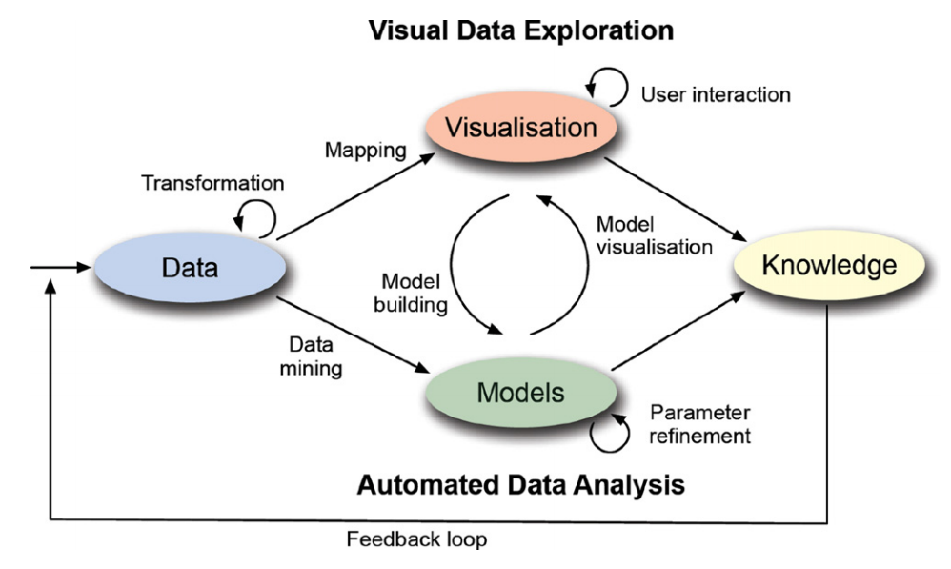
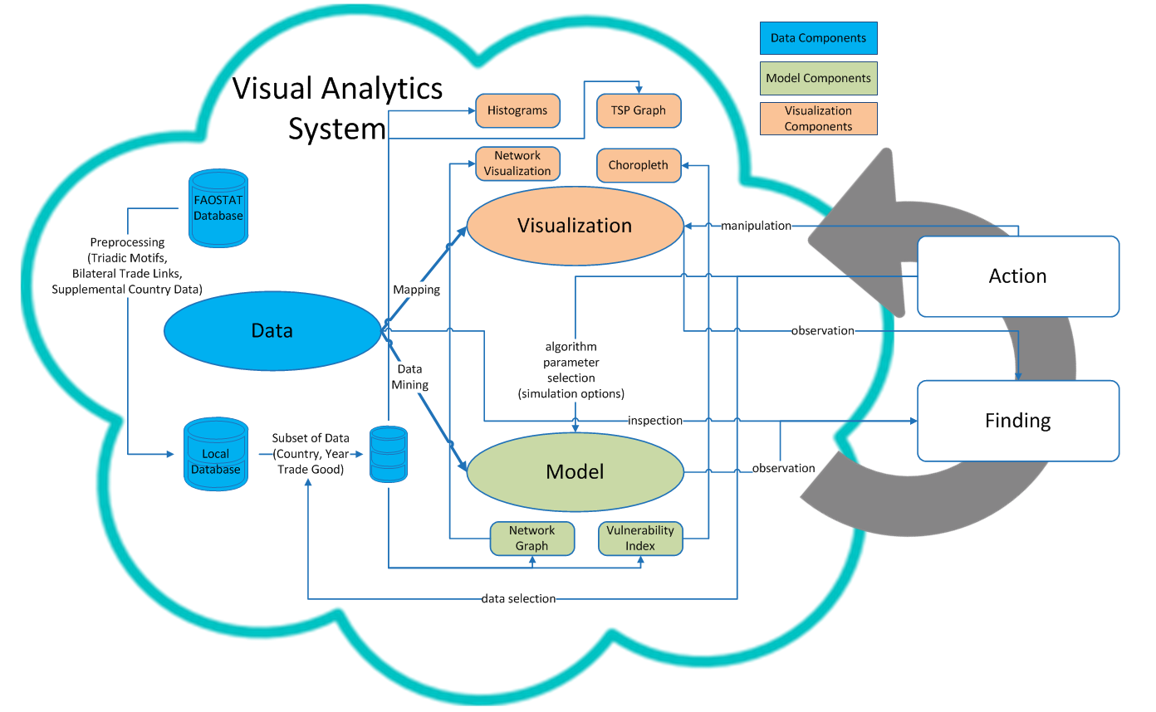
Visual Analytics
Typical Visual Analytics System
Keim et al. (2011)
My Visual Analytics System
motivated by Sacha et al. (2014)
Keim, D., J. Kohlhammer, M. Pohl, G. Santucci and G. Andrienko, “Solving problems with visual analytics”, Procedia Computer Science 7, 117–120 (2011).
Sacha, D., A. Stoffel, F. Stoffel, B. C. Kwon, G. Ellis and D. A. Keim, “Knowledge generation model for visual analytics”, IEEE transactions on visualization and computer graphics 20, 12, 1604–1613 (2014).
Notes:
Metric for risk/vulnerability, show math
Add details

Slide 16
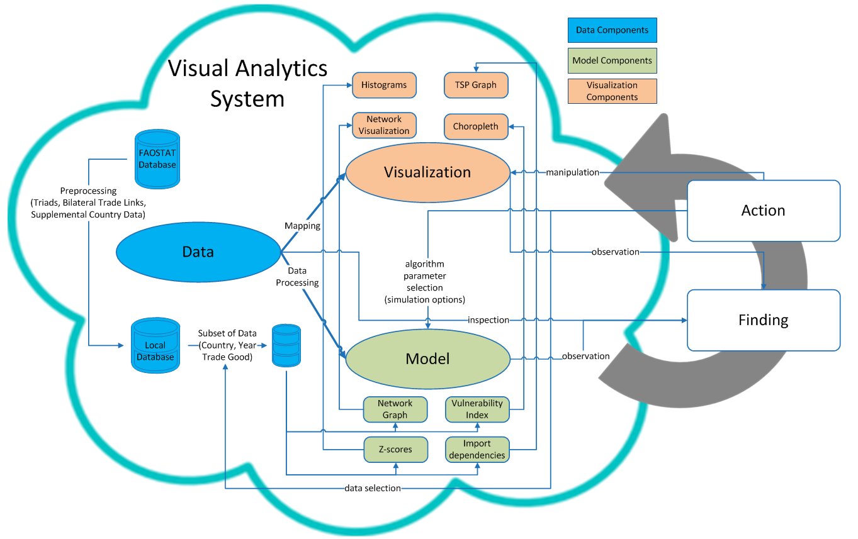
My Visual Analytics System Framework

Slide 17
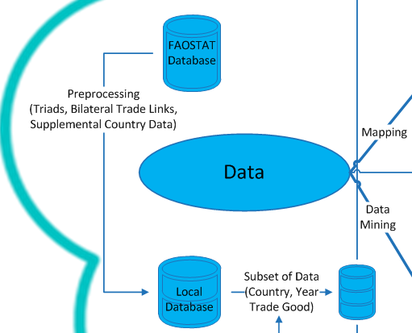
Visual Analytics
Data
Food and Agriculture Organization Corporate Statistical Database (FAOSTAT DB)
Snapshot of trade link data from 1986-2013
Trade link
Year
Crop (e.g. wheat)
Exporting country
Importing country
Dollar value
Notes:
What attributes are present in the database
Years, the crops
Import value,

Slide 18
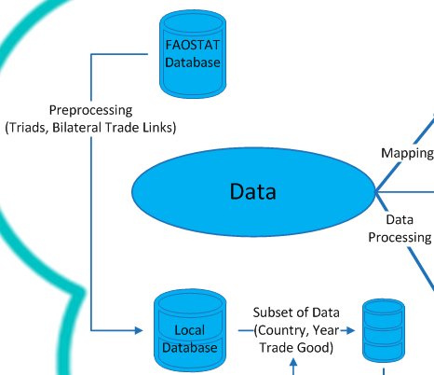
Visual Analytics
Data
Preprocessing
Triad calculation
Bilateral trade links
Selection
Interactions allow filtering of data
What year
What crop
What country
Notes:
Try ad

Slide 19
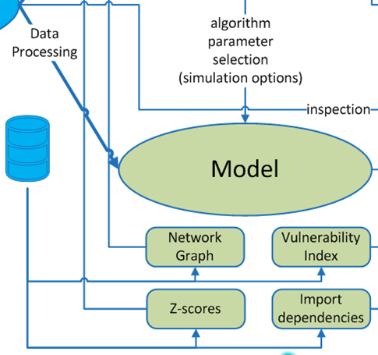
Visual Analytics
Model
Simulated Climate Event
Vulnerability Index
Import Dependency
Z-Score
Network Graph
Notes:
A couple of things I model for this framework
Cascading impact formula
What is dependency and how related to risk/vulnerability
Define vulner, show map, simulate drought in Thailand, what is the risk
Data assumption formula
Truncated case study

Slide 20
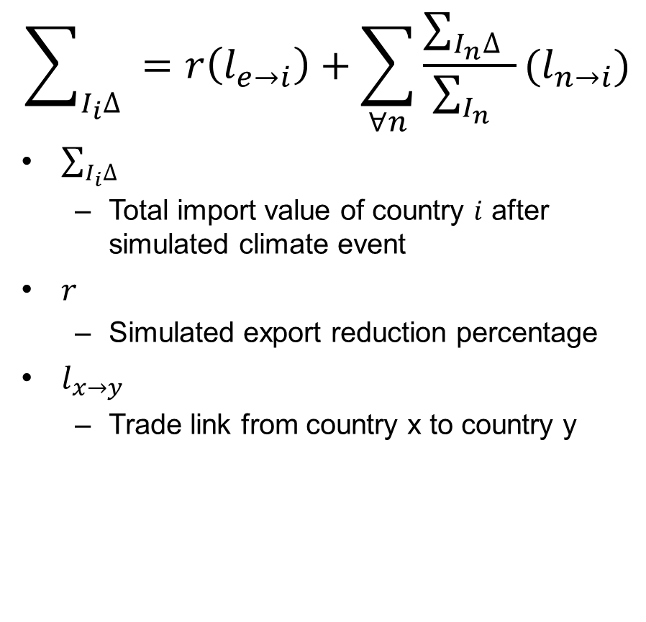
Visual Analytics
$$\sum_{I_{i}∆}{ }=r\left(l_{e→i}\right)+\sum_{∀n}^{ }{\frac{\sum_{I_{n}∆}{ }}{\sum_{I_{n}}{ }}}(l_{n→i})$$
$\sum_{I_{i}∆}{ }$
Total import value of country $i$ after simulated climate event
$r$
Simulated export reduction percentage
$l_{x→y}$
Trade link from country x to country y
Model
Simulated Climate Event
Vulnerability Index
Import Dependency
Z-Score
Network Graph
Notes:
A couple of things I model for this framework
Cascading impact formula
What is dependency and how related to risk/vulnerability
Define vulner, show map, simulate drought in Thailand, what is the risk
Data assumption formula
Truncated case study

Slide 21
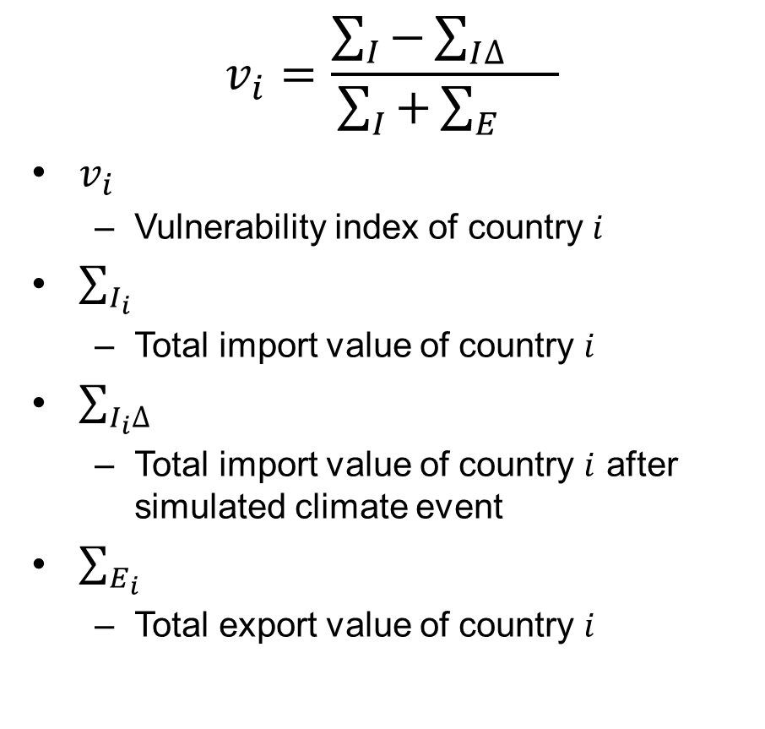
Visual Analytics
$$v_{i}=\frac{\sum_{I}{−\sum_{I∆}{}}}{\sum_{I}{+\sum_{E}{}}}$$
$v_{i}$
Vulnerability index of country $i$
$\sum_{I_{i}}{ }$
Total import value of country $i$
$\sum_{I_{i}∆}{ }$
Total import value of country $i$ after simulated climate event
$\sum_{E_{i}}{ }$
Total export value of country $i$
Model
Simulated Climate Event
Vulnerability Index
Import Dependency
Z-Score
Network Graph

Slide 22
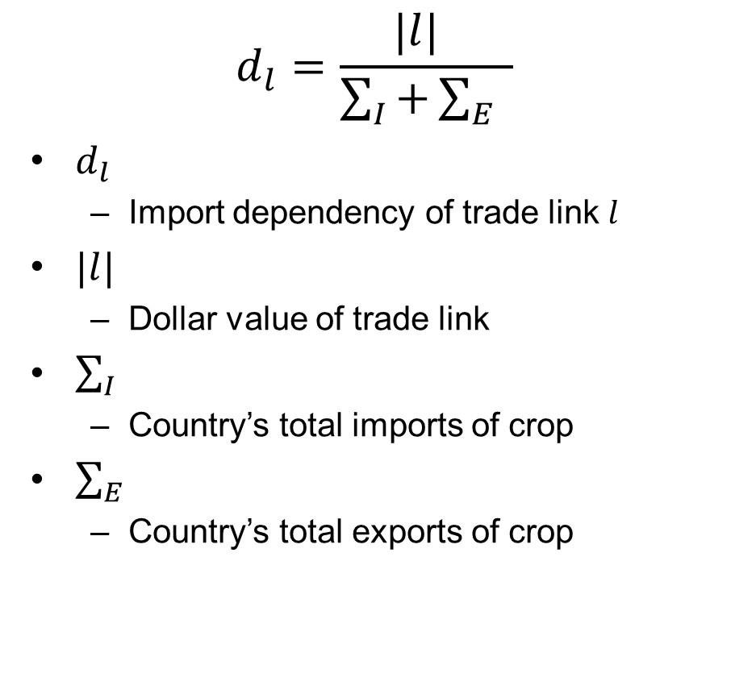
Visual Analytics
$$d_{l}=\frac{|l| }{\sum_{I}{+\sum_{E}{ }}}$$
$d_{l}$
Import dependency of trade link $l$
$|l|$
Dollar value of trade link
$\sum_{I}{ }$
Country’s total imports of crop
$\sum_{E}{ }$
Country’s total exports of crop
Model
Simulated Climate Event
Vulnerability Index
Import Dependency
Z-Score
Network Graph

Slide 23
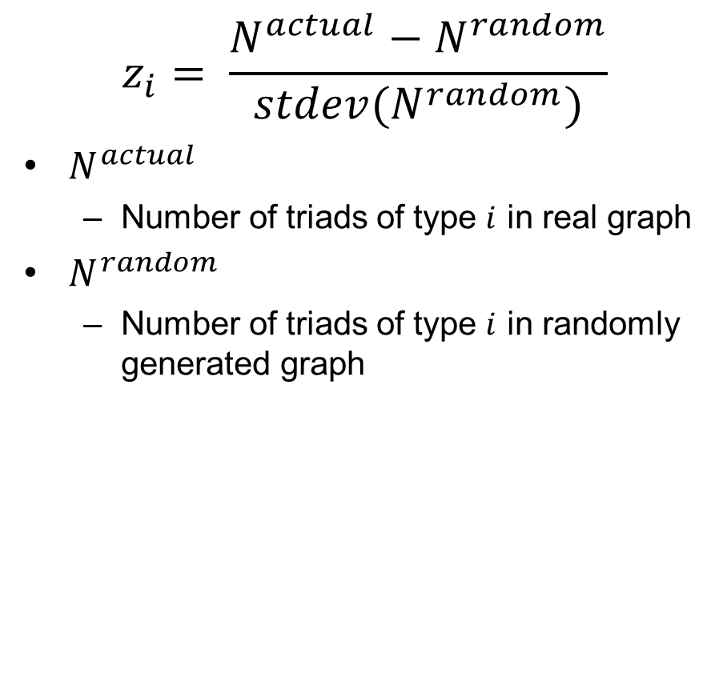
Visual Analytics
$$z_{i}= \frac{N^{actual}−N^{random}}{stdev(N^{random})}$$
$N^{actual}$
Number of triads of type $i$ in real graph
$N^{random}$
Number of triads of type $i$ in randomly generated graph
Model
Simulated Climate Event
Vulnerability Index
Import Dependency
Z-Score
Network Graph

Slide 24
Visual Analytics
Model
IFTN as weighted directed graph
Nodes are counties
Edges are trade links
Direction indicates the direction of trade (from exporter to importer)
Edges are weighted
Import dependency
Why?
High dependency on imports indicates a higher risk^{[1]}
Simulated Climate Event
Vulnerability Index
Import Dependency
Z-Score
Network Graph
[1] d’Amour, C. B., L. Wenz, M. Kalkuhl, J. C. Steckel and F. Creutzig, “Teleconnected food supply shocks”, Environmental Research Letters 11, 3, 035007 (2016).

Slide 25
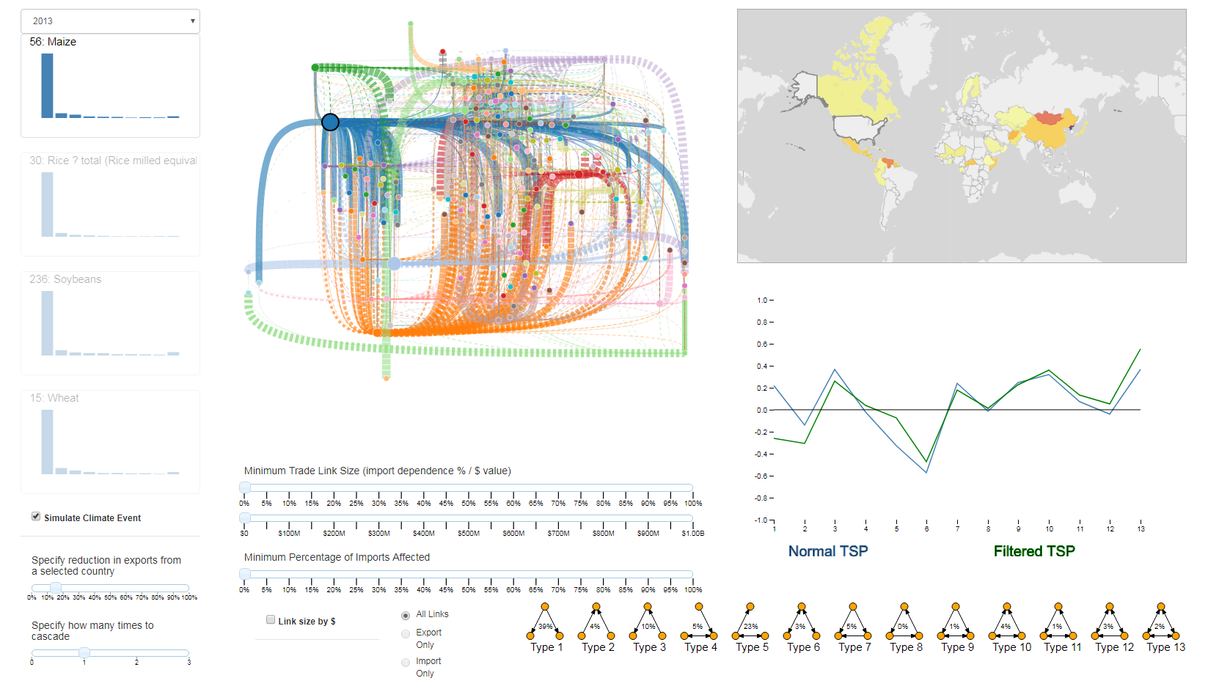
Visual Analytics System Dashboard
Notes:
Show the system
2013 corn export reduction from the US

Slide 26
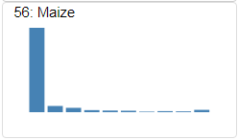
Histograms
Description
Histogram for corn 2013
Distribution of trade links based on import dependency
Links in the left-most bins indicate more diversified imports
Links in right-most bin indicate import portfolios that are made up of fewer trade links
The opaque indicates the currently selected crop
Clicking another histogram changes the context

Slide 27
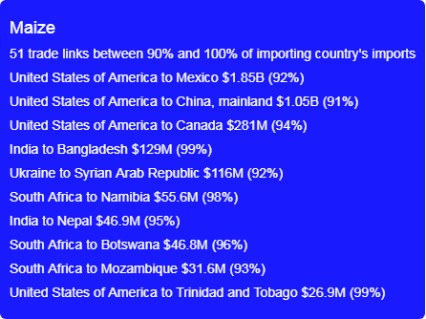
Histograms
GUI & Interactions
Tooltip of far right histogram bin
Tooltip shows the United States to Mexico corn trade link in 2013
$1.85 billion
92% of Mexico’s total imports of corn
High import ratio
If exports are also low this means a high import dependency

Slide 28
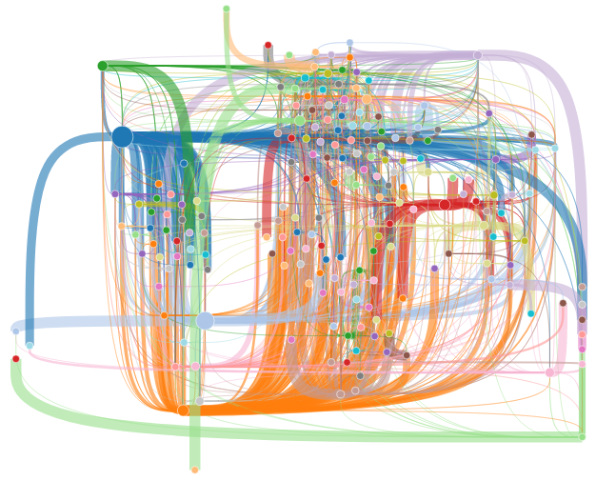
Network Graph
Description
Network graph for corn in 2013
Shows the entire trade network for the selected crop
Nodes are approximately geographically positioned
Labels added here for clarity
Thicker lines indicate a higher import dependency of that trade link
Color indicates direction
Links take the color of the exporter
US
Japan

Slide 29
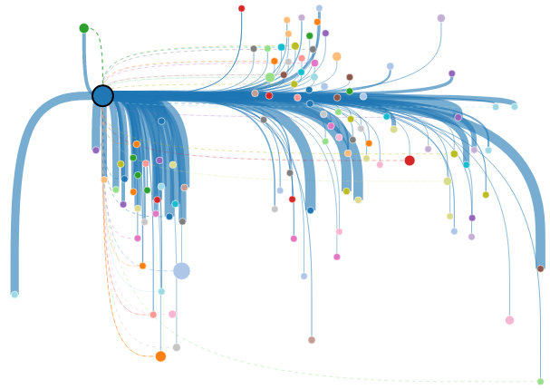
Network Graph
GUI & Interactions
Weighted by import dependency
Selecting a node filters the data to only show imports and exports associated with that country
Dashed lines indicate imports to selected country
These links looks fairly important
China
Japan
US
Mexico
French
Polynesia

Slide 30
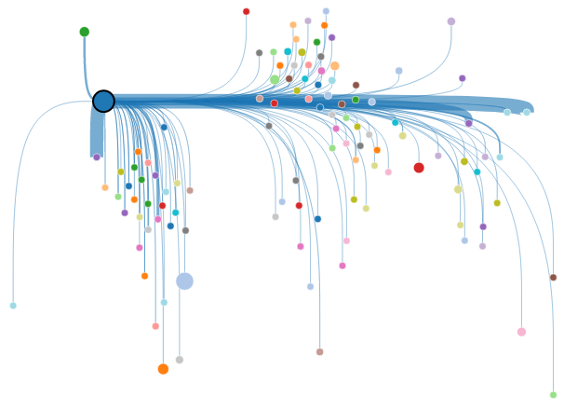
Network Graph
GUI & Interactions
Weighted by link dollar value
Using the dollar value as the weight gives context
We see Mexico again as in the histogram
Verification of import dependency
China
US
Japan
Mexico
French
Polynesia
Notes:
Change the weighting to be by dollar value

Slide 31
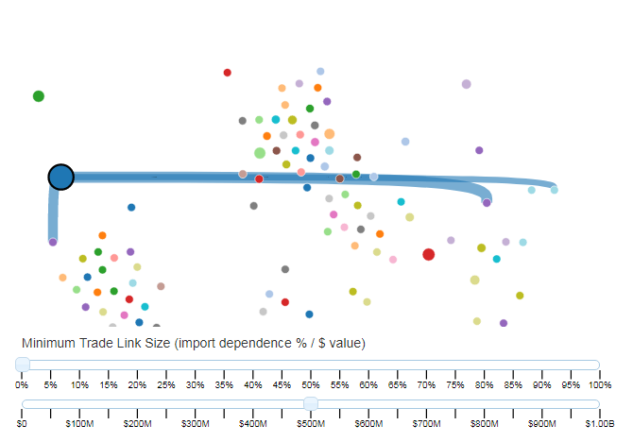
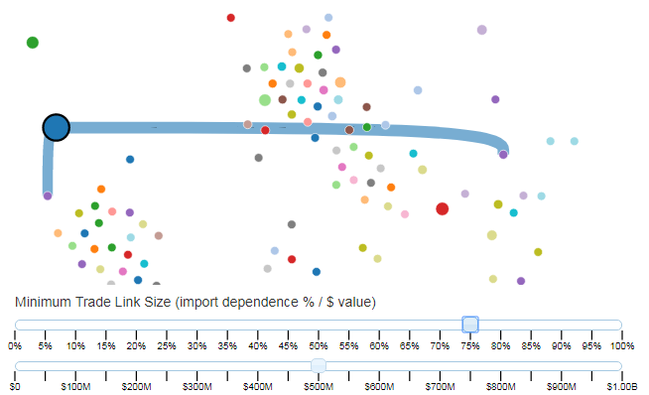
Network Graph
GUI & Interactions
Weighted by import dependency
Or we could have just filtered
Filtered by trade links of ≥ $500 million in value
Filtered by import dependence ≥ 75%
In this way we are able to look for import dependent links of high value
China
US
Japan
Mexico

Slide 32
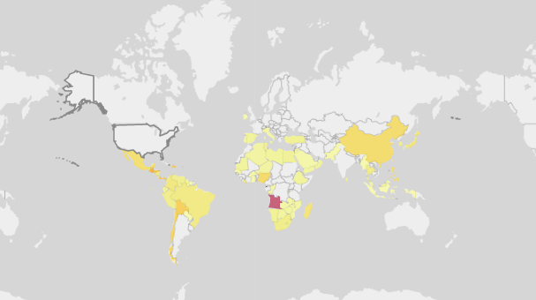
Choropleth Map
Description
Choropleth of 15% wheat reduction from the United States
Displays vulnerability indices based on simulation results
Darker red indicates a high vulnerability index

Slide 33
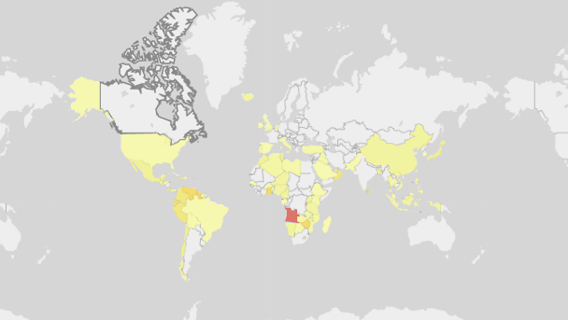
Choropleth Map
GUI & Interactions
Choropleth of 15% wheat reduction from Canada
Clicking a country here also selects it for the simulation

Slide 34
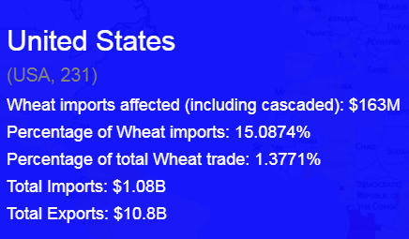
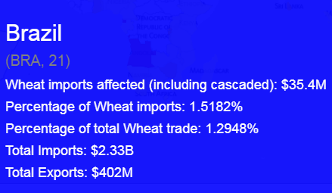
Choropleth Map
GUI & Interactions
Choropleth of 15% wheat reduction from Canada
The United States and Brazil are similarly colored
United States has 15% of its imports affected
Brazil imports are affected by 1.5%
Why?
Vulnerability is also a function of exports
Notes:
Example here of how exports affect vulnerabiltiy

Slide 35
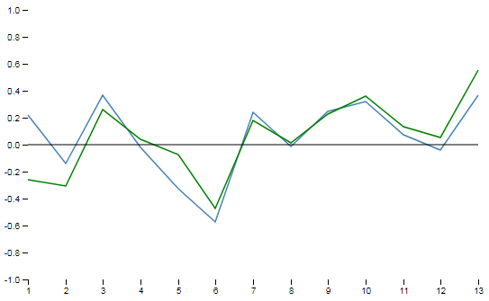
Triad Significance Profile Graphs
Description
TSPs for 2013, Green is corn and
Blue is the four staple crops
Graphs the z-scores of the triad significance profiles
The research in this thesis focused more on cascading impacts to the trade network
Future work will explore the impact of removing network connectors on distributions of triads

Slide 36
Outline
Problem
Developed a visual analytics system for exploring second-order effects of climate change under the lens of global trade
Current visualizations
Case studies demonstrating the use of the system
Notes:
We’ll move on to our solution

Slide 37
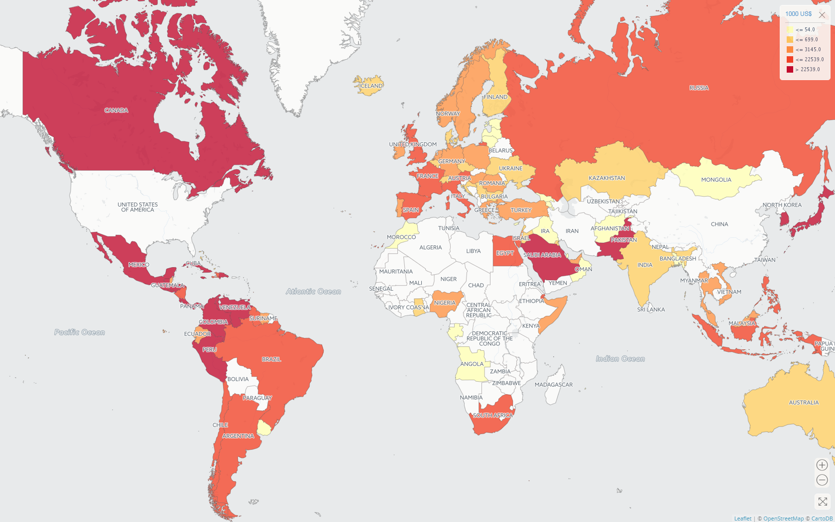
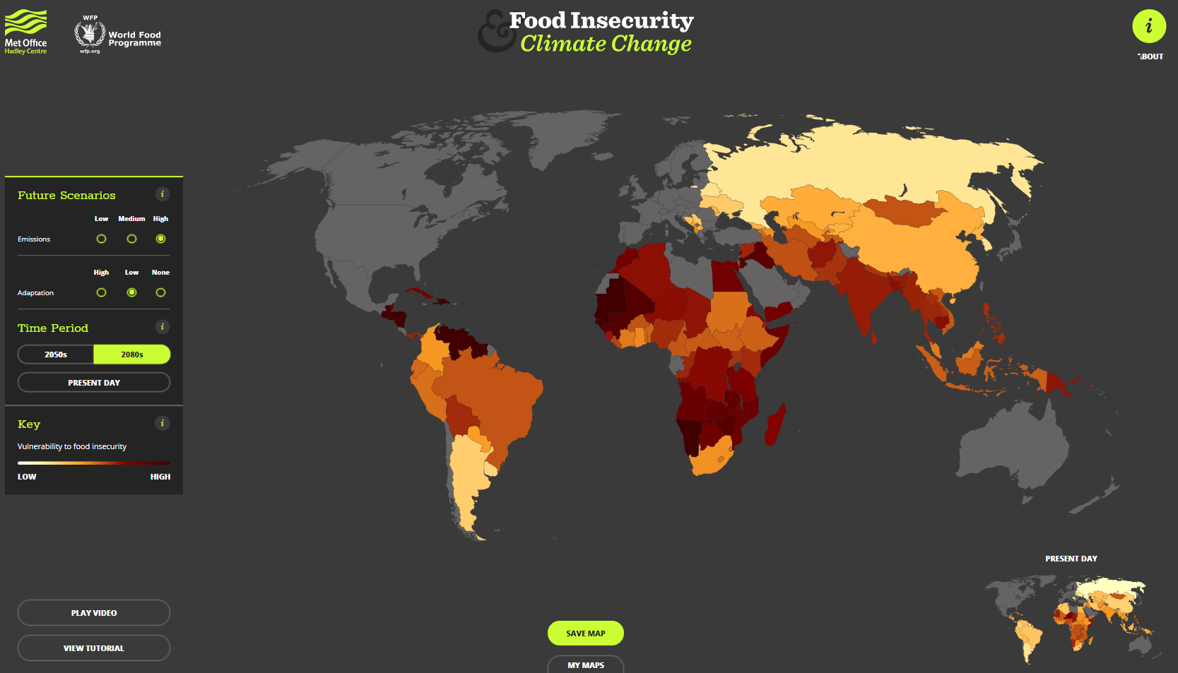
Current Visualizations
Met Office Food Insecurity & Climate Change (www.metoffice.gov.uk/food-insecurity-index)
FAOSTAT Data Visualization
(www.fao.org/faostat/en/#data/TM/visualize)
Notes:
Notice they are both choropleths, it’s hard to visualize a network like this.
Comparisons after the system

Slide 38
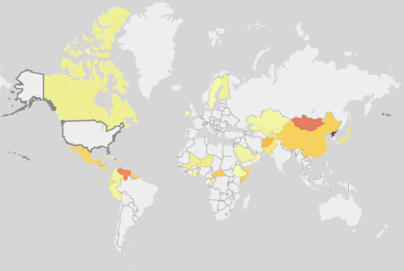
Current Visualizations: Comparisons
Met Office Food Insecurity & Climate Change (www.metoffice.gov.uk/food-insecurity-index)
My System
Notes:
Choropleth makes sense as a representation of vulnerability:
Left: Global scale
Right: Response to climate event

Slide 39
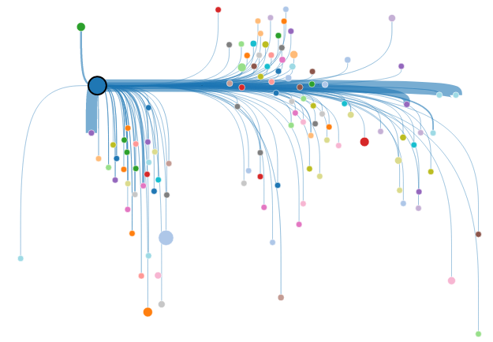
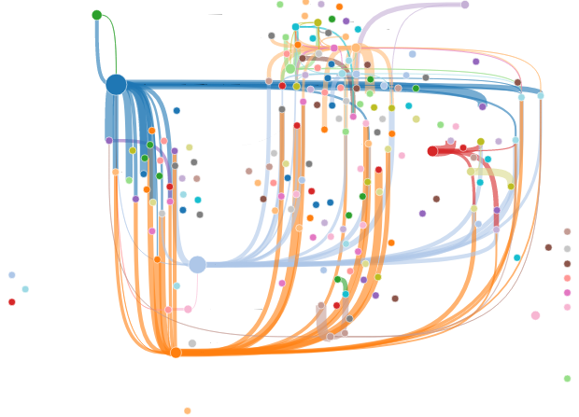
Current Visualizations: Comparisons
FAOSTAT Data Visualization
(www.fao.org/faostat/en/#data/TM/visualize)
My System
Canada
US
From here it looks like Canada and Mexico both import about the same
Mexico
In reality Mexico imported $1.85 billion and Canada $281 million
Notes:
FAOSTAT Viz
Again choropleth, may not be best representation a trade network
First filtered to show the same information
Deceiving visualization
My system allows to visualize the whole network
Show entire system first
Label nodes

Slide 40
Current Visualizations: Limitations
The food trade network and food security indices are not modeled together
Not a visual analytic system!
No analysis
Notes:
Main limitation is the lack of the two being modeled together

Slide 41
Outline
Problem
Developed a visual analytics system for exploring second-order effects of climate change under the lens of global trade
Current visualizations
Case studies demonstrating the use of the system
Notes:
Introduce my system more

Slide 42
Case Studies
2011 Chinese drought
Simulated US Climate Event

Slide 43
Case Studies
2011 Chinese drought
Simulated US Climate Event

Slide 44
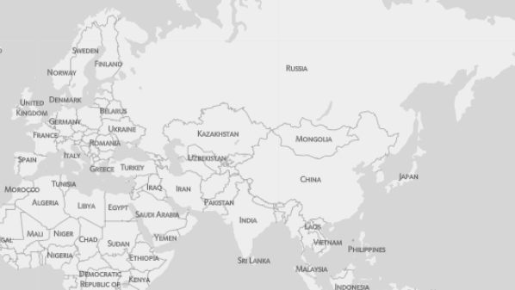
Case Study: 2011 Chinese Drought
A regional climate event potentially had a global effect on food security
The recent Arab Spring has been linked to this regional drought^{[1]}
How does a drought in China affecting wheat production cause political instability in Egypt?
China doesn’t export wheat to Egypt
?
[1] Sternberg, T., “Chinese drought, bread and the Arab Spring”, Applied Geography 34, 519–524 (2012).
Notes:
All the steps
Label all pertinent nodes in the graph
Delete in

Slide 45
Case Study: 2011 Chinese Drought
Food trade network can affected by reduced production or export bans
Large increase in wheat imports to China drives up international prices
Russia continues existing export bans on wheat
From the previous year’s poor harvest due to drought^{[1]}
?
[1] Fellmann, T., S. H´elaine and O. Nekhay, “Harvest failures, temporary export restrictions and global food security: the example of limited grain exports from Russia, Ukraine and Kazakhstan”, Food Security 6, 5, 727–742 (2014).

Slide 46
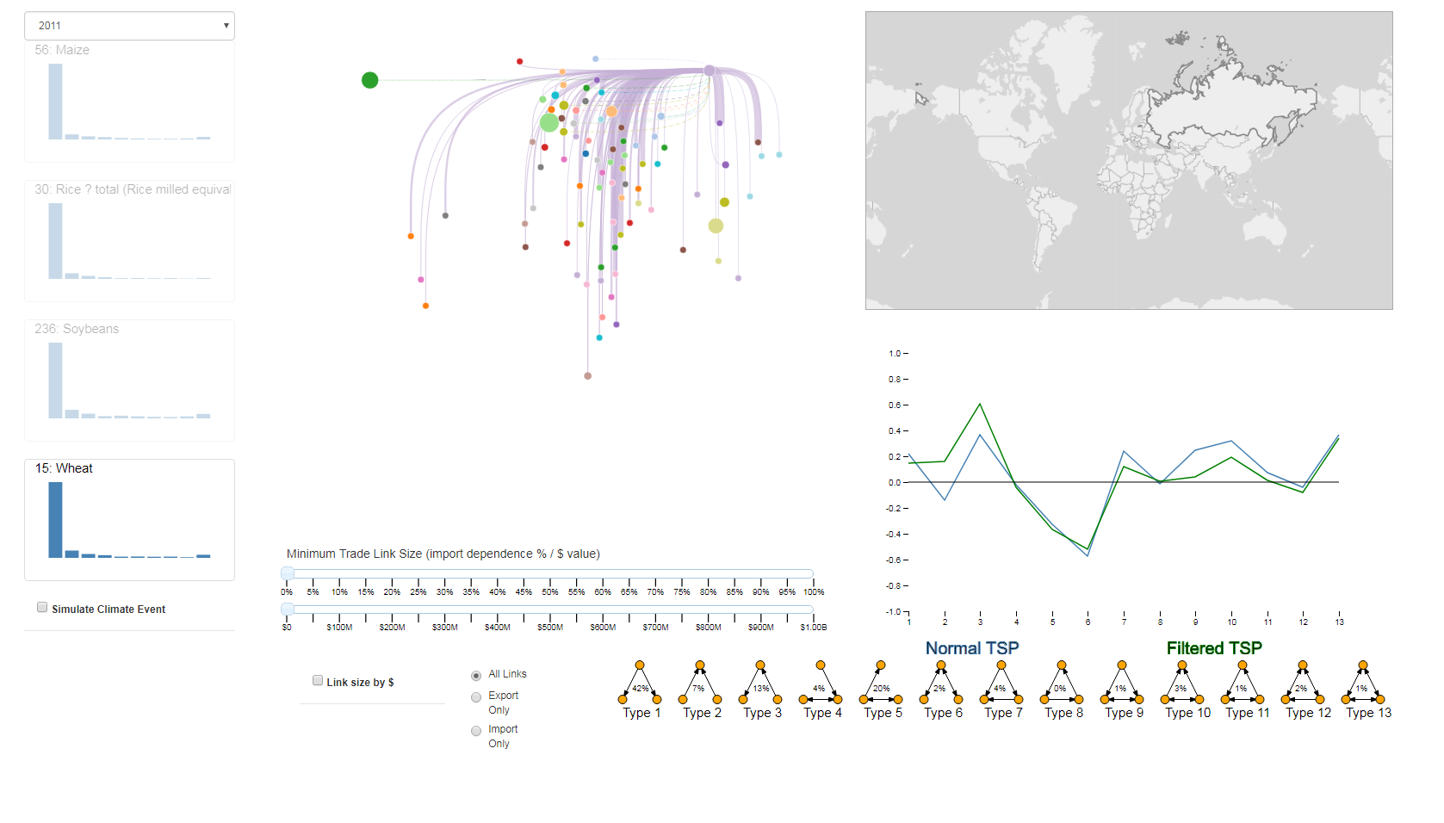
Case Study: 2011 Chinese Drought
Notes:
Select 2011, Wheat, and Russia

Slide 47
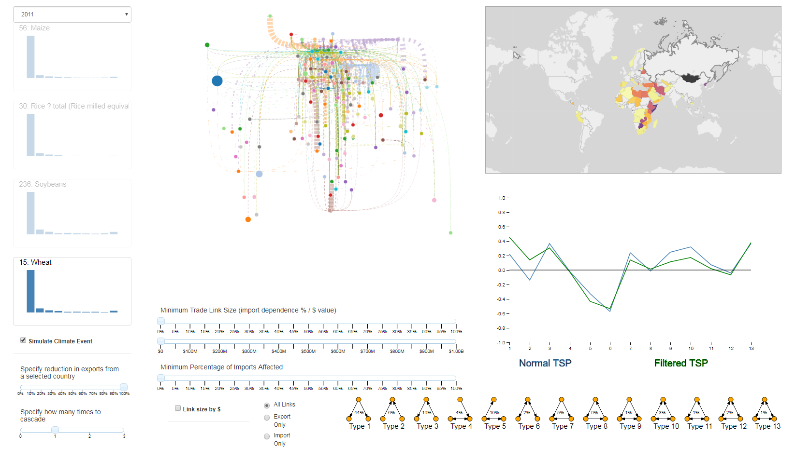
Case Study: 2011 Chinese Drought
Notes:
Check simulate, change % to 100

Slide 48
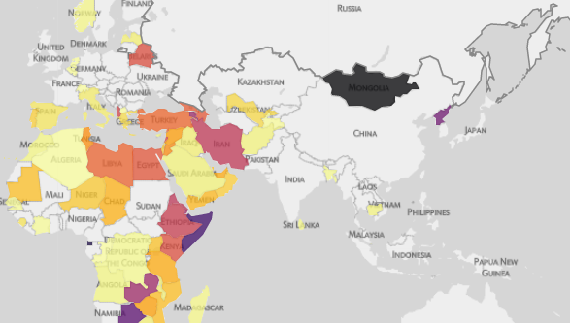
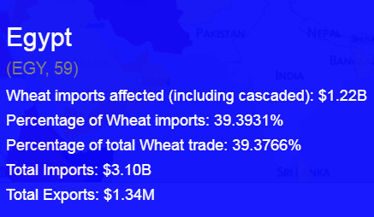
Case Study: 2011 Chinese Drought
Results
Notes:
Zoom in to Egypt on Choropleth
And hovering over the country

Slide 49
Case Studies
2011 Chinese drought
Simulated US Climate Event

Slide 50
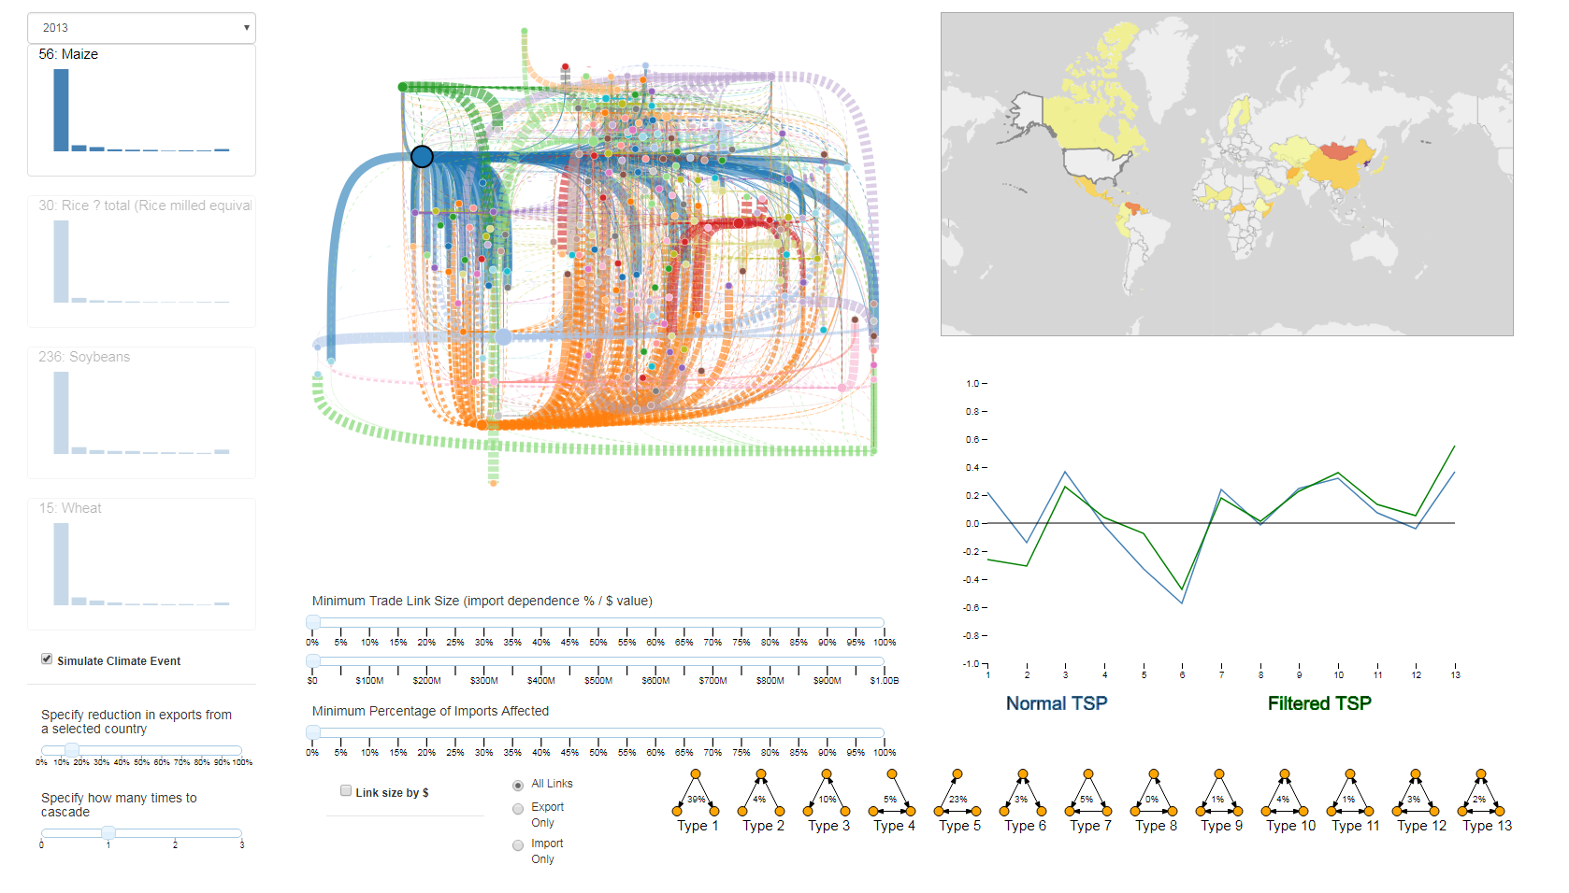
Case Study: Simulated US Climate Event
To highlight cascading effects, we simulate a climate event in the United States
Very busy network graph
Dashed lines are indirect links

Slide 51
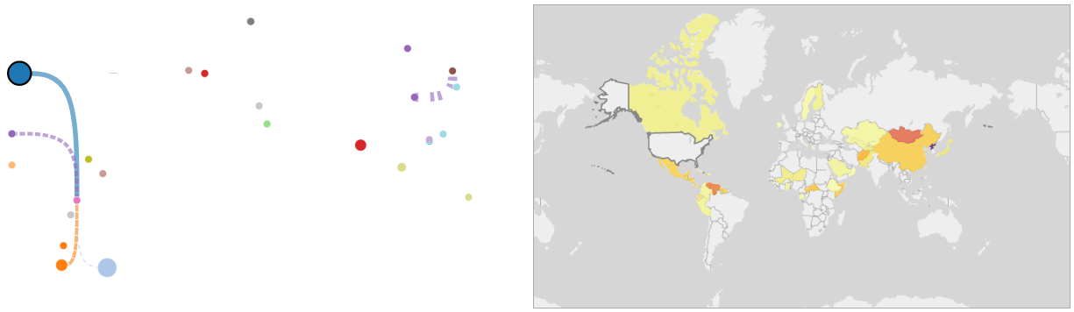
Case Study: Simulated US Climate Event
Add filtering to the network graph
Minimum Trade Link Size ($25 million)
Minimum Percentage of Imports Affected (30%)
Identify two countries of interest: Venezuela and North Korea
(Mongolia is red too, but they only import $109k)
United States
North Korea
Venezuela

Slide 52
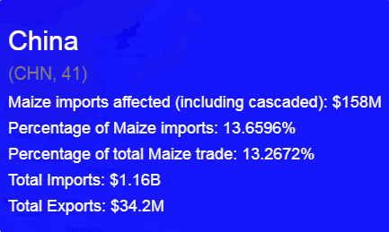
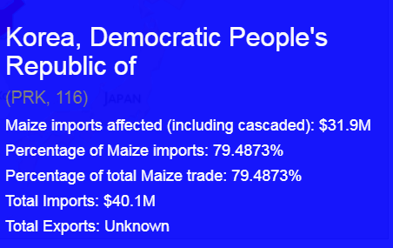
Case Study: Simulated US Climate Event
Results:
North Korea has no direct link from the US yet it has lost ~79% of its corn imports
The reduction in imports to China is cascaded to North Korea
Note: There is
No direct trade link!

Slide 53
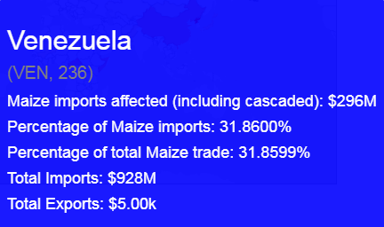
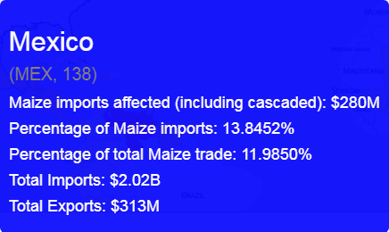
Case Study: Simulated US Climate Event
Results:
Venezuela has lost ~32% of its corn imports from a 15% US export reduction
The reduction in imports to Mexico is cascaded to Mexico
Note: US to Venezuela trade link is only $55 million

Slide 54
Conclusion
Questions?

Slide 55
Edge crossing
Understand it was important
Purchase, H., “Which aesthetic has the greatest effect on human understanding?”, in “International Symposium on Graph Drawing”, pp. 248–261 (Springer, 1997).
Reviewed
Dunne, C. and B. Shneiderman, “Motif simplification: improving network visualization readability with fan, connector, and clique glyphs”, in “Proceedings of the SIGCHI Conference on Human Factors in Computing Systems”, pp. 3247–3256 (ACM, 2013).
Holten, D. and J. J. Van Wijk, “Force-directed edge bundling for graph visualization”, in “Computer graphics forum”, vol. 28, pp. 983–990 (Wiley Online Library, 2009).
Felt it was important to keep countries separate, grouping them could skew vulnerability
i.e. Saudi ($769m import of wheat 2013) and Qatar ($36m import of wheat 2013) right next to each other
Mental mapping
We are familiar with where countries are located
Lots of filtering and interactions (dragging network graph) available to minimize
Notes:
Hide and keep for potential questions
Examples of risk profile, math on cascading effecets

Slide 56
Visual Variables
Notes:
Hide and keep for potential questions
Examples of risk profile, math on cascading effecets

Slide 57
Triads
Cascaded or second-order effects
Triad types 3, 4 & 7 account for around 20% of triads, indicating this paradigm exists
Triad distributions for four staple crops in the year 2013
Notes:
Hide and keep for potential questions
Examples of risk profile, math on cascading effecets

